Slide 1
DES
Display Technology
Dalian Good Display Co., Limited
Ver.20190930

Slide 2
1
E-paper Display Application
2
New Technology - DES
3
Performance Difference Between Original Technology and The DES
CONTENTS
Cost Difference Between Original Technology and The DES
Contents
4
5
Full Range of The DES Displays
6
Sample Comparison Between Original Technology and The DES
7
Wide Application Areas for DES in The Future

Slide 3
CONTENTS
PART 01
E-paper Display Application

Slide 4
E-paper Display Application
E-book
E-notebook
E-book is a handheld reader that digitizes the content of text, pictures, sounds, images, and the like, and a set of storage and display terminals that embed or download digital text, pictures, sounds, images, and the like.
E-notebook is a kind of intelligent high-tech product that can replace traditional notebook and original handwriting. It is the latest fashion technology product and green product. It is mainly used for political and business people to use for mobile office and entertainment.

Slide 5
E-paper Display Application
Electronic Price Tag
An electronic display device that can replace the traditional paper price tag, is connected to the store database through the network, and displays the latest product information.
Electronic Price Tag
Electronic Price Tag
It is an electronic display device with information transmission and reception function, and is mainly used in electronic labels for displaying price information in supermarkets, convenience stores, pharmacies, and the like.
The shelf was incorporated into the computer program, freed from the manual replacement of price tags, and the price consistency between the checkout counter and the shelf was achieved.

Slide 6
现有电子纸显示屏的应用

Slide 8
CONTENTS
PART 02
New Technology - DES
Display Electronic Slurry（DES）

Slide 9
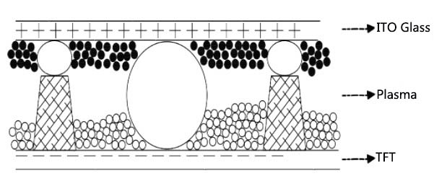
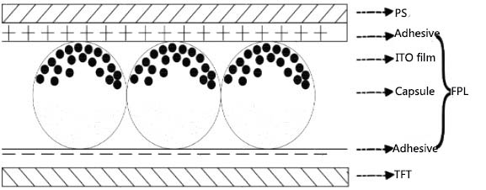
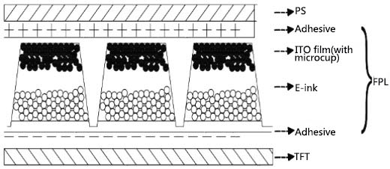
Structure Diagram of New and Original Technology
Cofferdam
Micro-cup
Micro-capsules
Display Electronic Slurry（DES）
The DES display module adopts a new display structure which is completely different from the current micro-cup and micro-capsule structure. The structure forms a layer of cofferdam structure on the surface of the TFT by forming a cofferdam around the periphery of a single pixel electrode, and the bank covers the source and gate lines on the TFT. The patterned structure is characterized in that each pixel electrode is surrounded by a cofferdam, the microstructure is not visible on the front side, and the number of layers is reduced, thereby obtaining the higher definition and resolution display effect. In order to distinguish it from the traditional micro-cup and micro-capsule technology, we call it the new display electronic slurry (DES) technology.

Slide 10
Pixel Display Difference
Micro-capsule Pixel Display
Micro-cup pixel display
DES pixel display

Slide 11
Process Difference Between Original Technology and The DES
The New
The Old
TFT
ES
ITO
IC
FPC
TFT
FPL
PS
IC
FPC
CELL
EPD Module
ES: Electronic Slurry FPL: Front Plane Laminate

Slide 12
E-ink Front Plane Laminate (FPL) Proccess
Charged particle
Aluminum film
FPL
ITO film pressure sensitive adhesive
Solvent
Capsule
Coated ITO film (micro-cup)

Slide 13
Composition of ES (Electronic Slurry)
Hydrotropic
Solvent
ES
Charged Pigment

Slide 14
CONTENTS
PART 03
Performance Difference Between Original Technology and The DES

Slide 15
Performance Difference Between EPD and DES
Operating Temperature.
Working Humidity
DES：-20℃~60℃
EPD：0℃~50℃
DES：0℃~80℃
EPD：25℃~60℃
Contrast
Resolution
DES：>1 : 45
EPD-BW：<1 : 8
EPD-Tri-color：<1 : 25
DES：Max 600DPI
EPD：Max 300DPI
Power consumption
DES：1~3mA
EPD：2~5mA

Slide 16
CONTENTS
PART 04
Cost Difference Between Original Technology and The DES

Slide 17
Cost Difference
EPD
DES
Cost Reduction↓

Slide 18
CONTENTS
PART 05
Full Range of The DES Displays

Slide 19
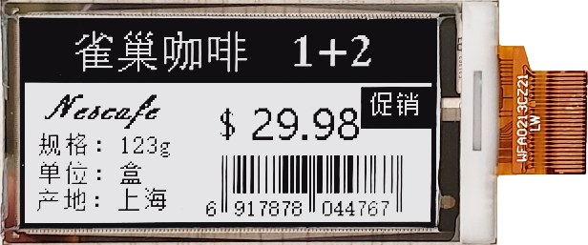
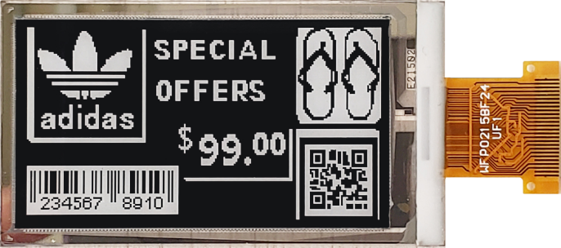
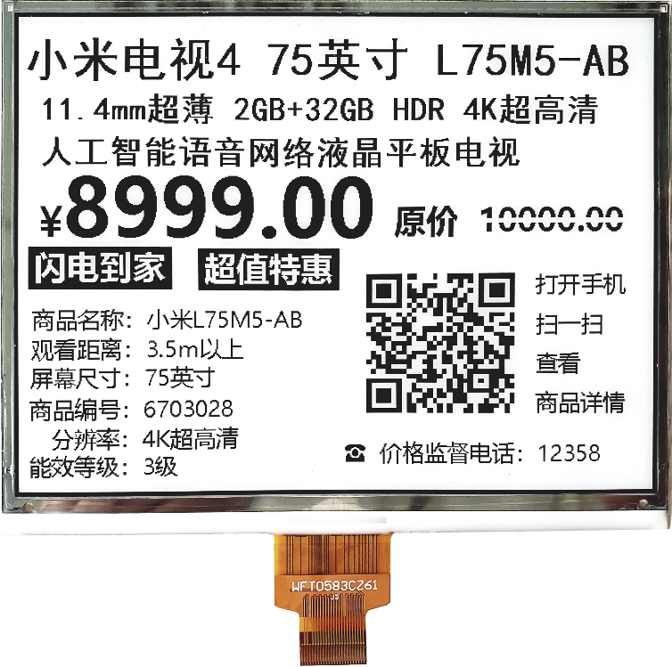
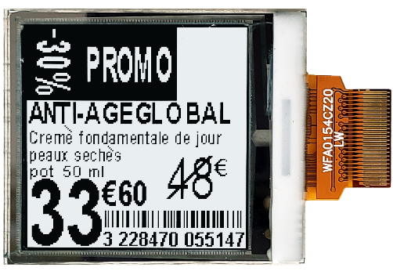
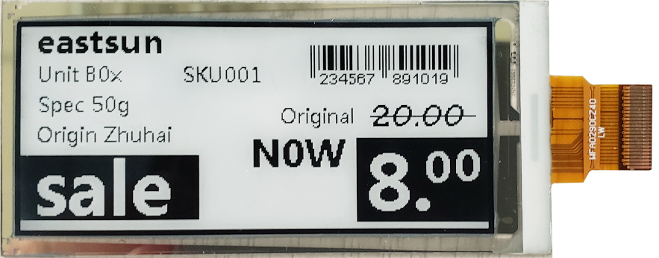
BW Series
2.13 inch
2.15 inch
5.83 inch
1.54 inch
2.9 inch

Slide 20
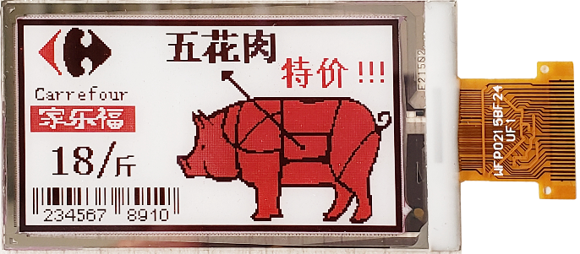
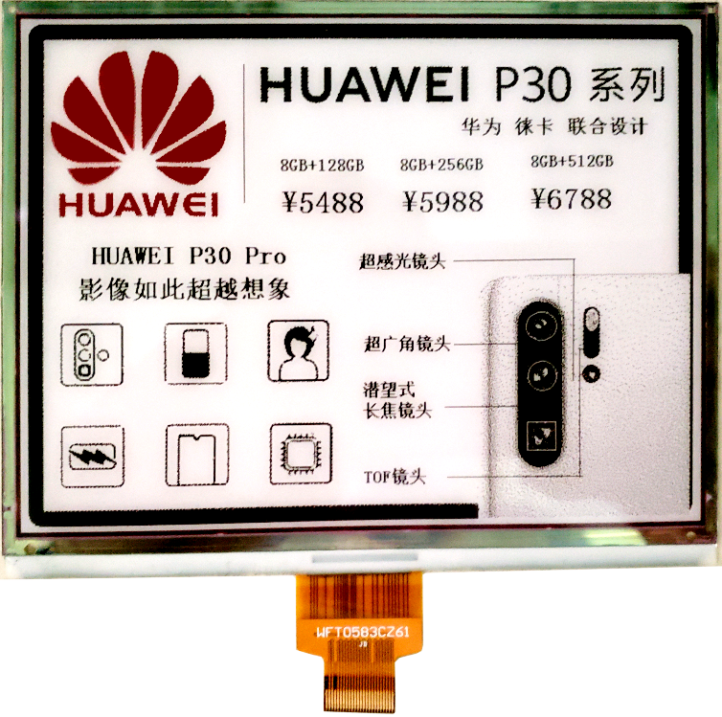
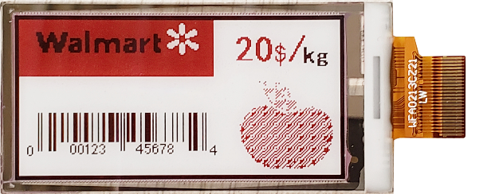
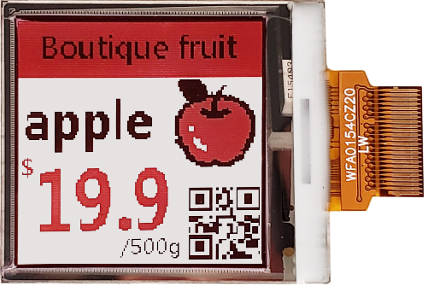
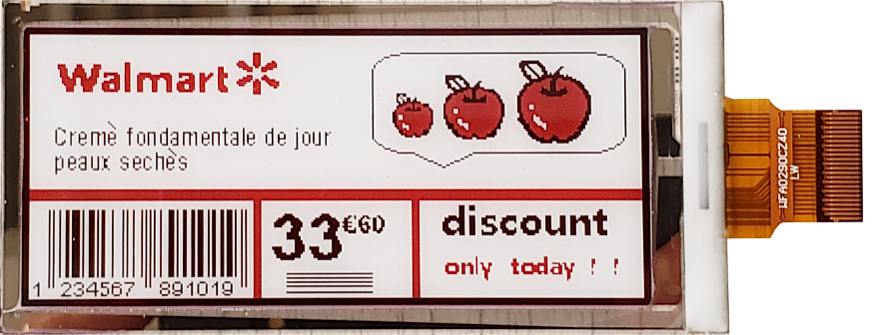
BWR Series
2.13 inch
2.15 inch
5.83 inch
1.54 inch
2.9 inch

Slide 21
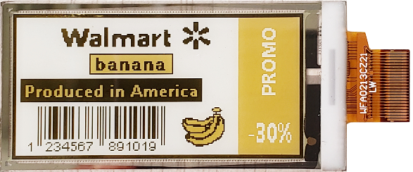
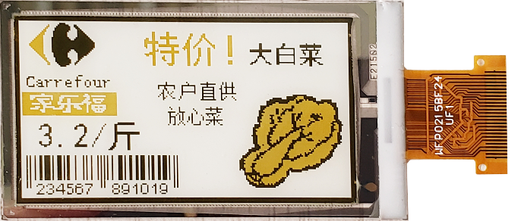
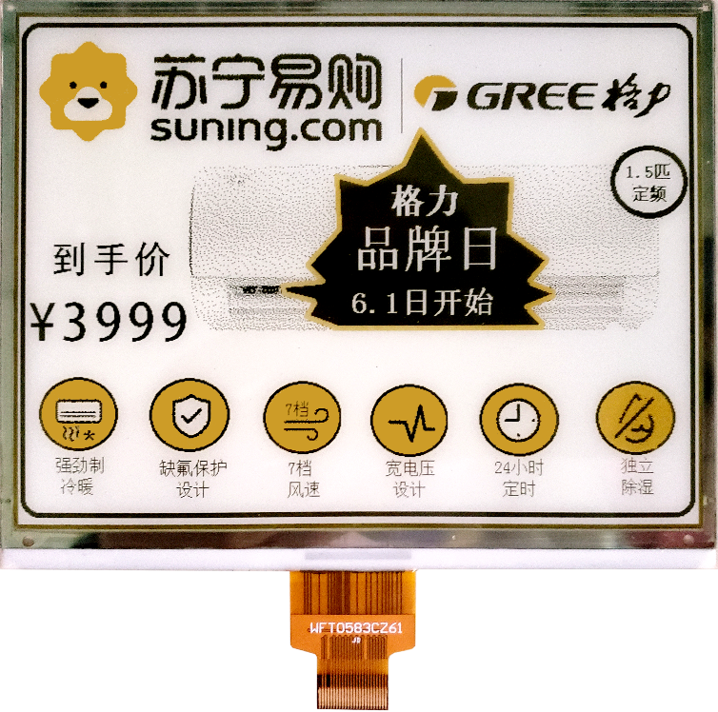
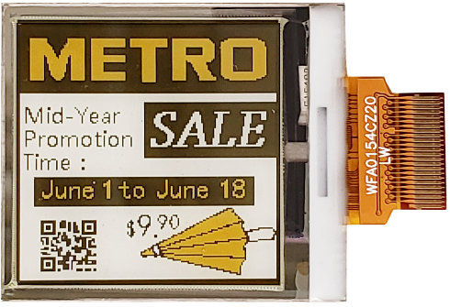
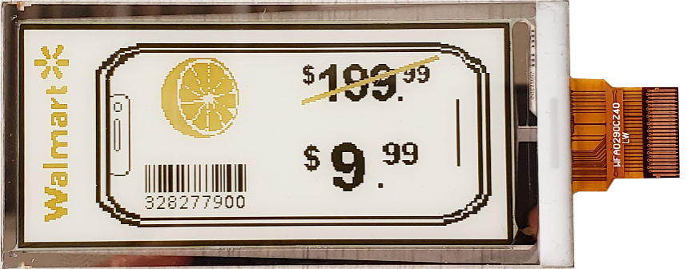
BWY Series
2.13 inch
2.15 inch
5.83 inch
1.54 inch
2.9 inch

Slide 22
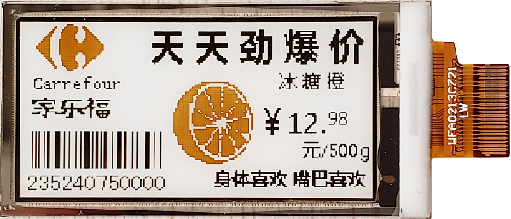
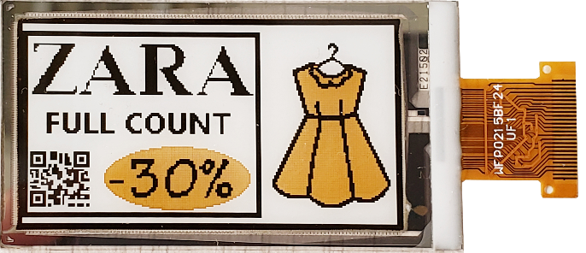
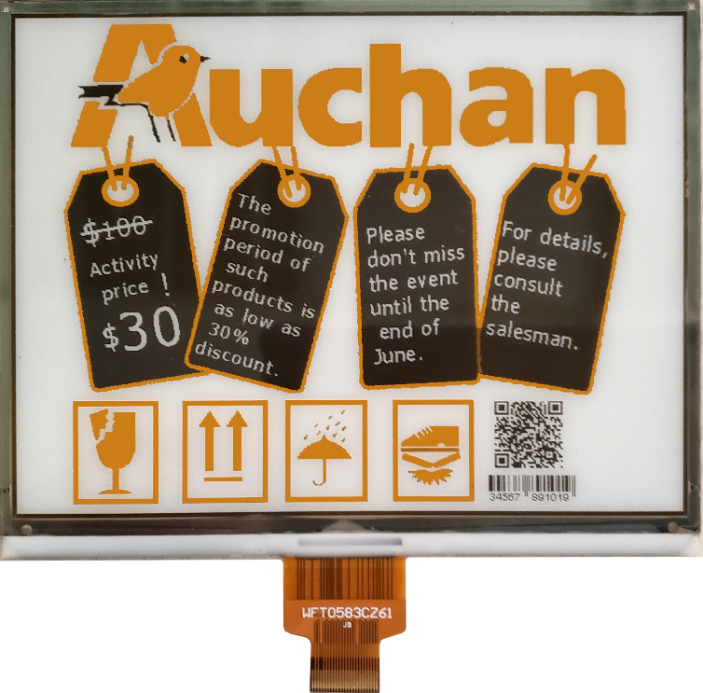
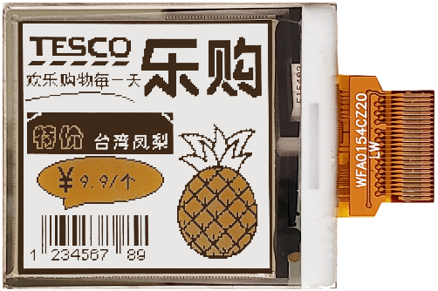
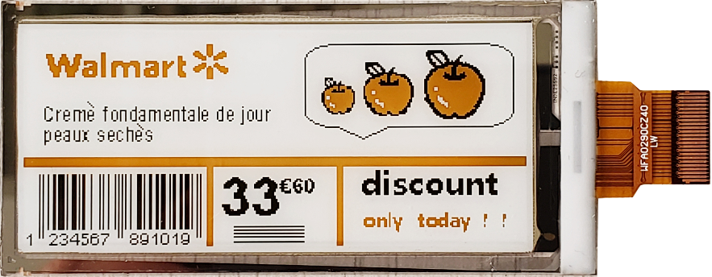
BWO Series
2.13 inch
2.15 inch
5.83 inch
1.54 inch
2.9 inch

Slide 23
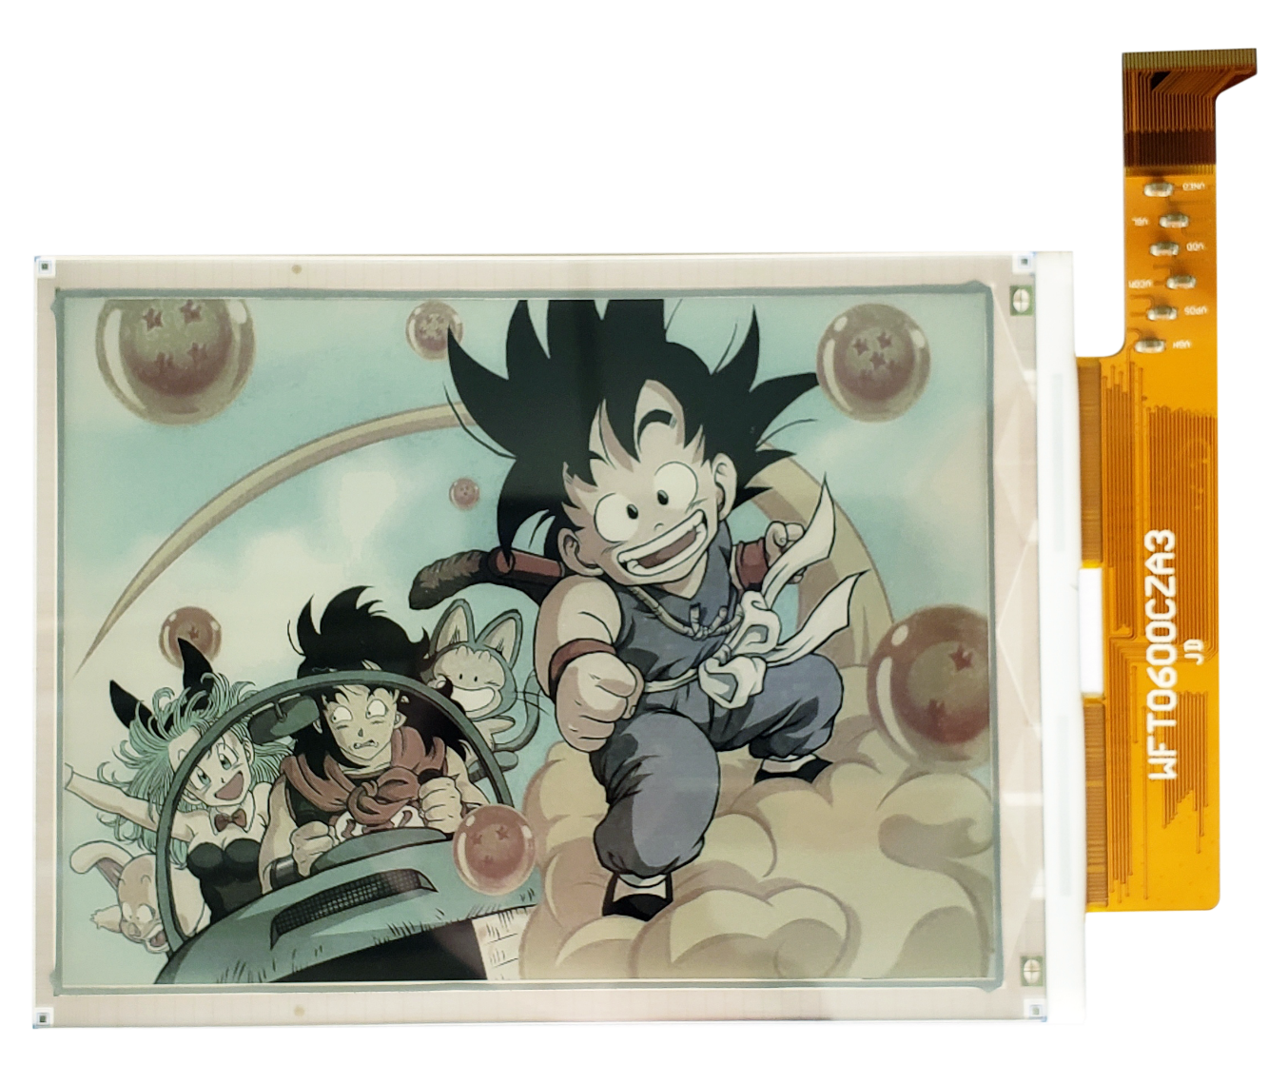
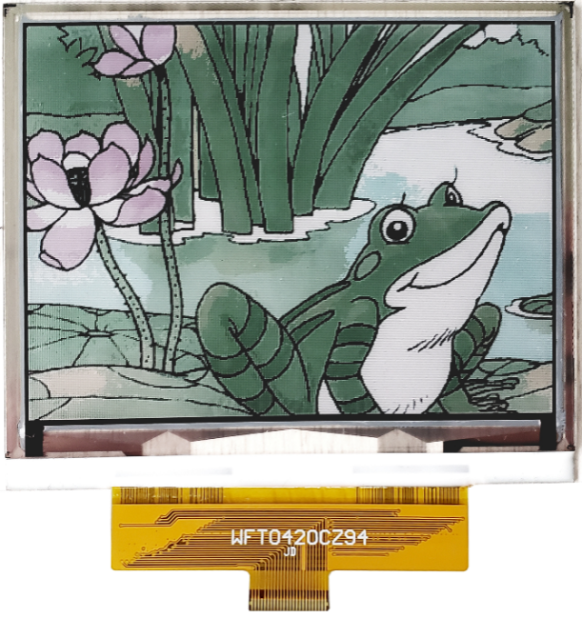
Full Color Series
4.2 inch
6 inch

Slide 24
CONTENTS
PART 06
Sample Comparison Between Original Technology and The DES

Slide 25
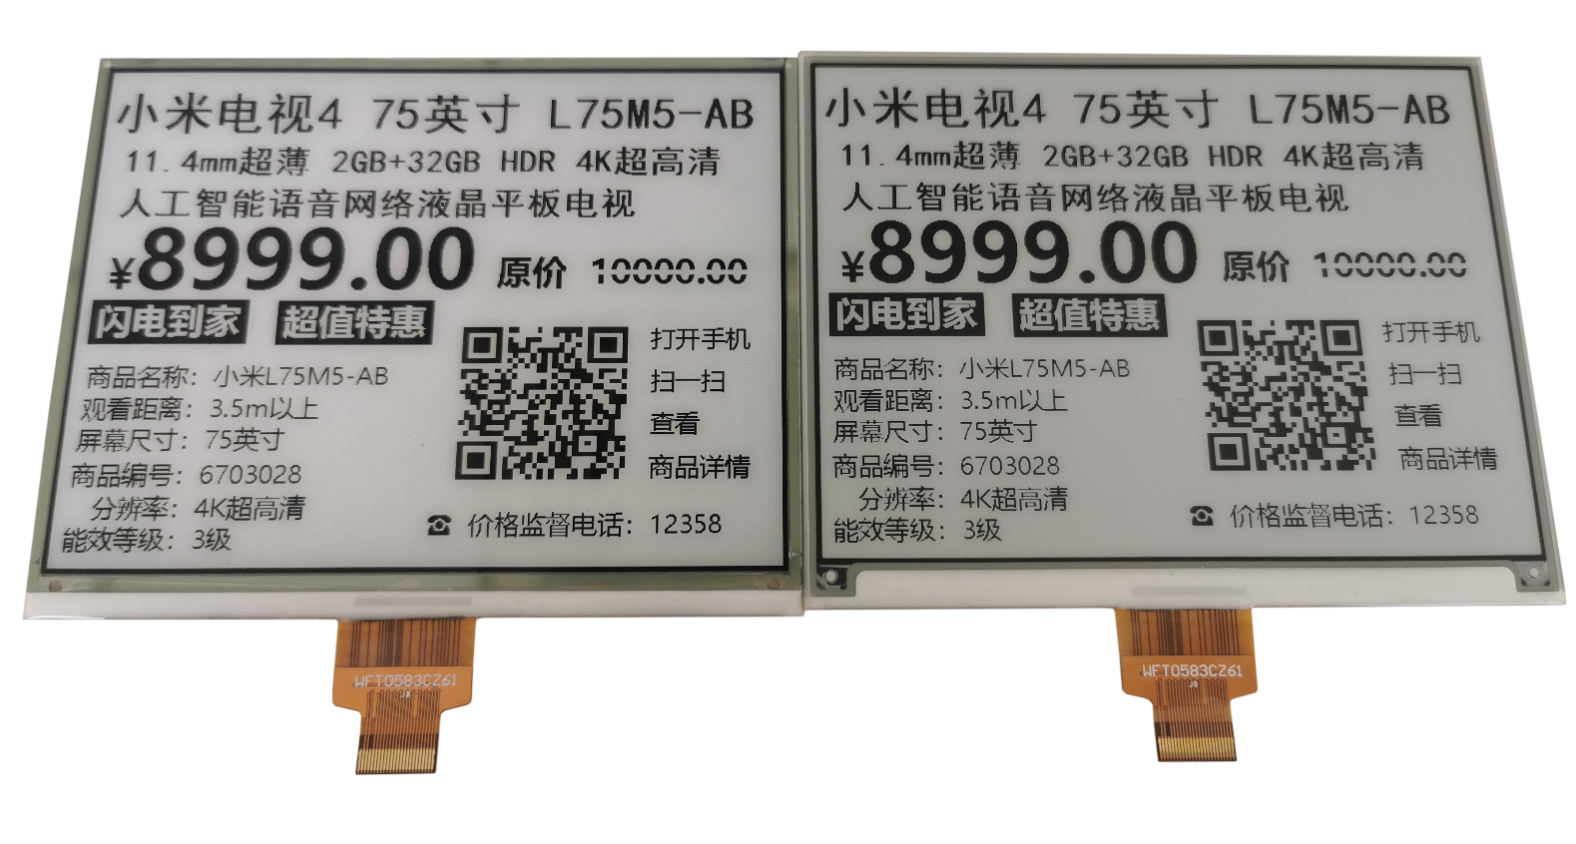
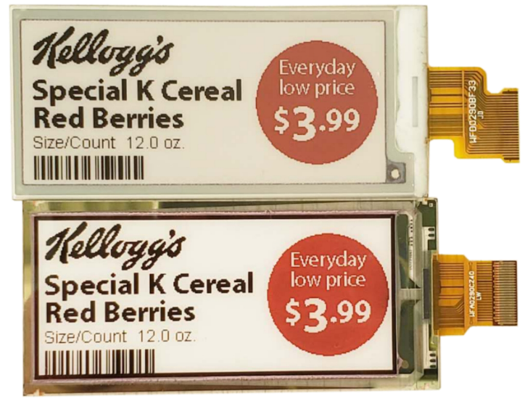
Sample Comparison Between EPD and DES
EPD
DES
DES
EPD

Slide 26
CONTENTS
PART 07
More Application for DES in The Future

Slide 27
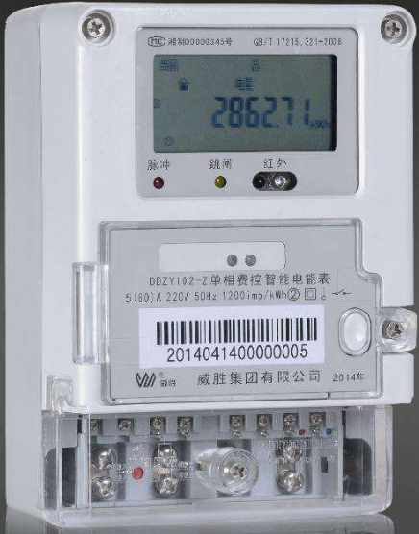
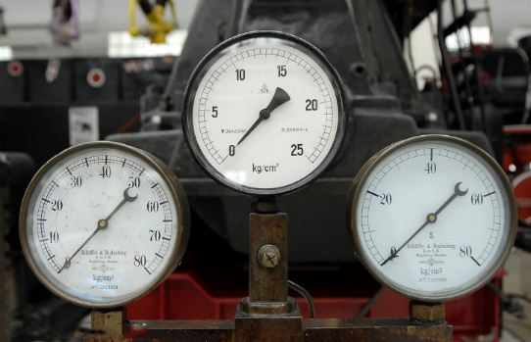
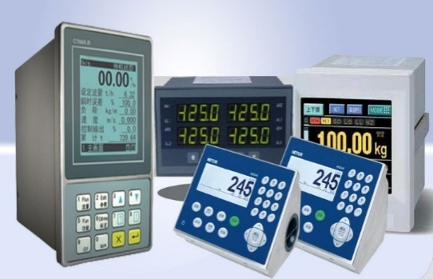
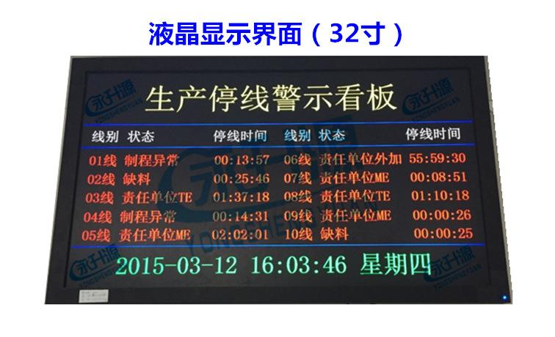
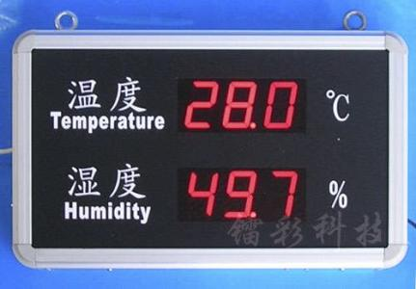
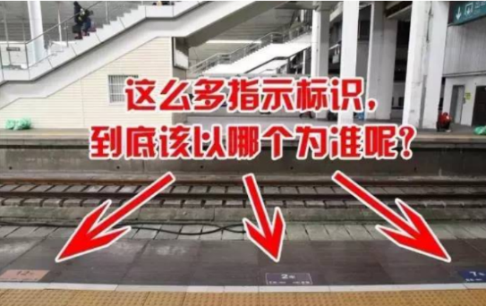
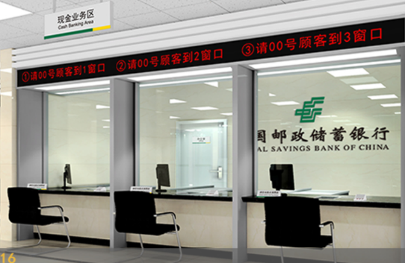
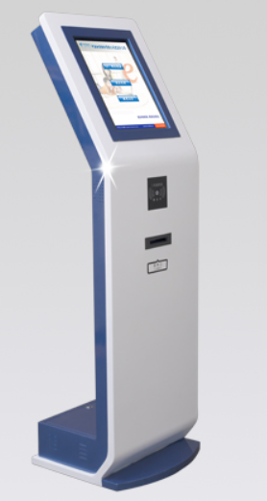
Other Exploitable Application
Pressure Gauge
Electric Meter
Instrumentation
Production Line Signate
Temperature and
Humidity Board
Station Waiting Sign
……
Bank Counters
Queuing Machine

Slide 28
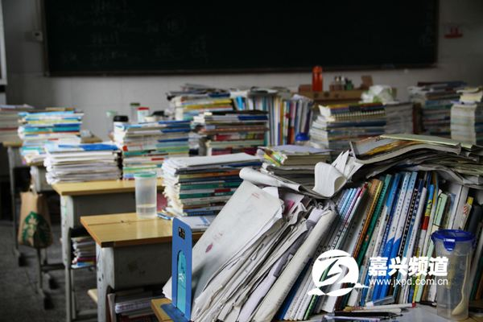
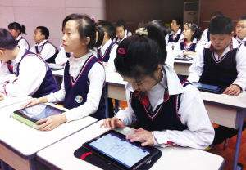
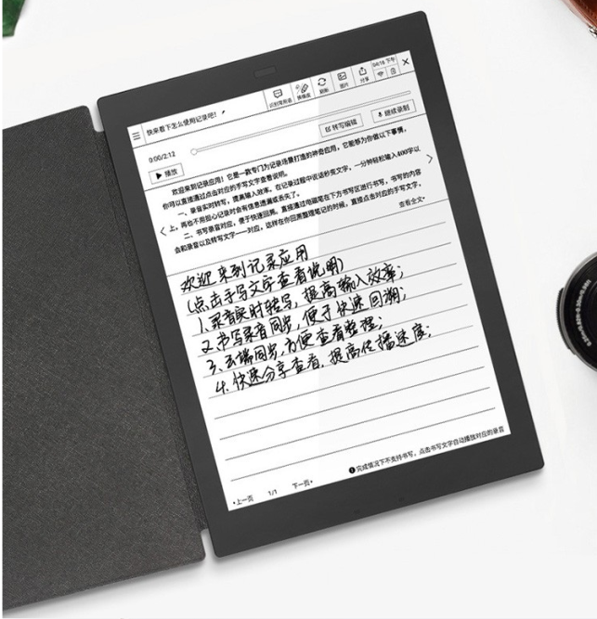
Other Exploitable Application
Smart Classroom
……

Slide 29
DES
Display Technology
Thanks For Watching
Ver.20190930

